Slide 1

Movie Recommender system
User Manual
Author: Sidhant Sinha
Notes:
Preworks course home assignments

Slide 2
Acknowledgements
This internship would have not been possible without the brilliant mentors that I have. The efficiency in the replies provided by them and the support given them is the only reason I was able to make my project.

Slide 3
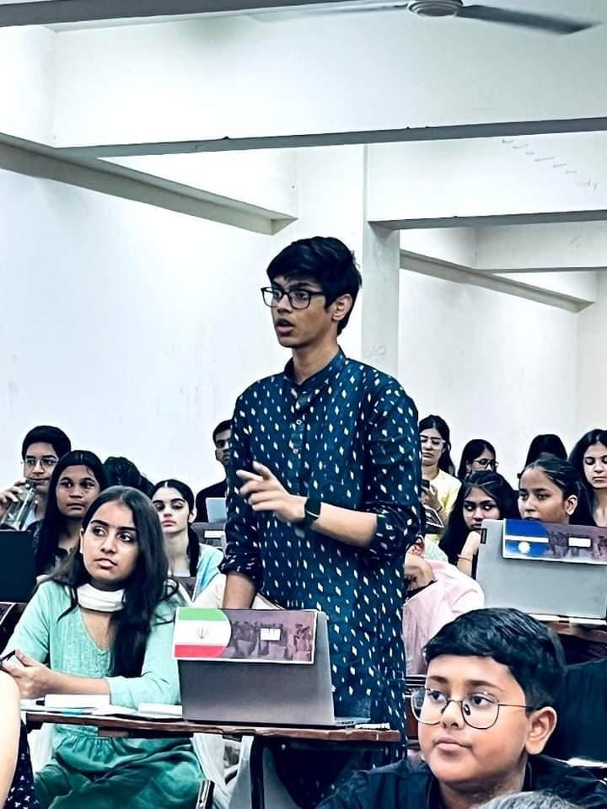
About Me..
Sidhant Sinha
I am currently in class 11th with subjects PCM.
I am currently in Amity international school, Mayurihar.

Slide 4
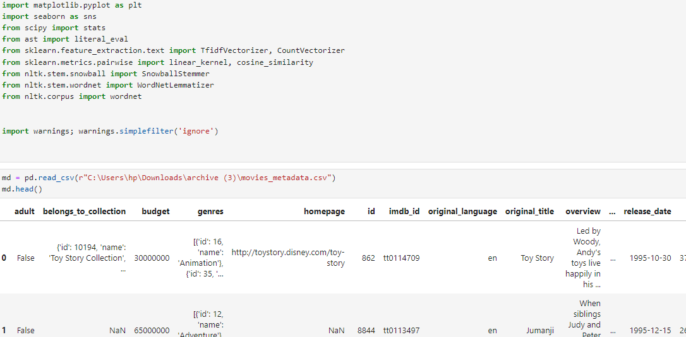
About My Internship Journey with Clevered..
.
The journey with cleared has been phenomenal and I have gained a lot of knowledge about AI and python.

Slide 5
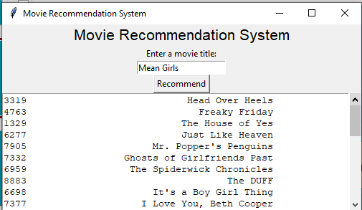
About App..
This movie recommender system works on different genres.
This system has 3 different recommenders.

Slide 6
How do I use the App?

Slide 7

Search Bar
A very simple user interface of the app includes a search bar for the movies.
However, this search bar is case sensitive and the user needs to be careful with the capitalization of what he/she is searching

Slide 8

Recommend Button
The recommend button requires only one click to bring out all the recommended movies that matches the user’s input.
This will only show a result if the user’s input is properly framed with correct capitalization.

Slide 9
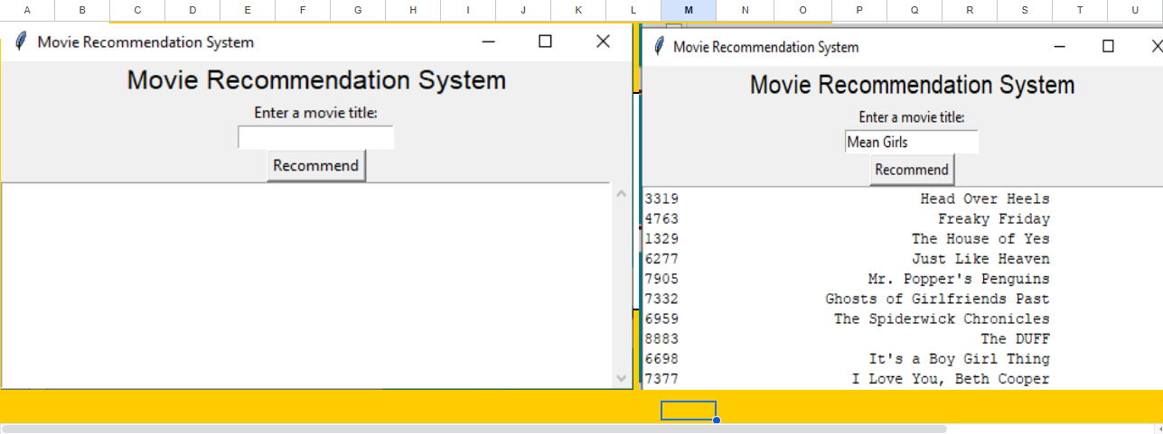
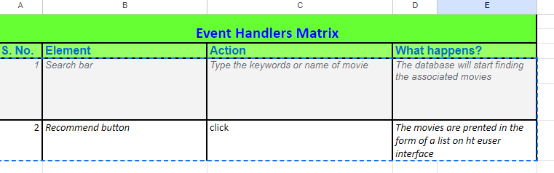
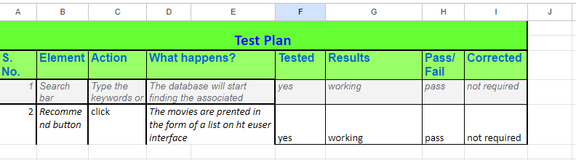
Toolkit Walkthrough
Github –
Linkdin-

Slide 10
Contact Person
Please reach out to Sidhant sinha on email address for any questions/ concerns/ suggestions on the App
Email:sidhantsinha634@gmail.com

Slide 11
Thank you!

